Slide 1




Take 10 with 4-H
Contest Resources

Slide 2
Volunteer Resources
The Volunteer Development Work group (VDWG) worked diligently to collect and create contest resource material to provide a contest overview for agent use and volunteer information.
Resources available
1. Contest Poster – List of Contests
2. Contest Guides – Power points that can be tailored to fit individual counties
3. Contest Carnival - Santa Fe Contest resource shared by Christina Turner at 2022 4-H In-Service.
Contest Poster was created to provide an overview of NM 4-H Contests. This is an overview and not all contests may be provided at county, district or state levels.
Contest Guides were created to provide agent, volunteers and parents with an overview of the 4-H contests. They are in a power point format so that agents may modify and/or add information specific to their respective county.
Contest Carnival was created by Christina Turner when she served as 4-H Agent in Santa Fe County Extension Office and has been shared as a resource for agents.

Slide 3
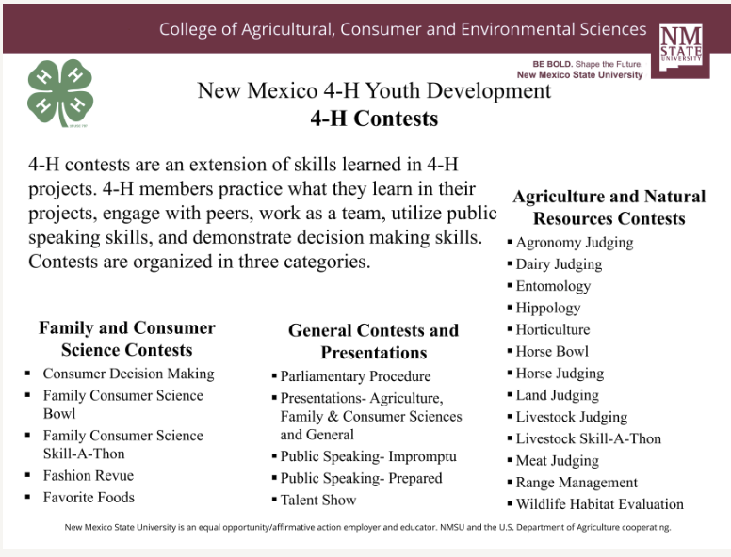


Slide 4
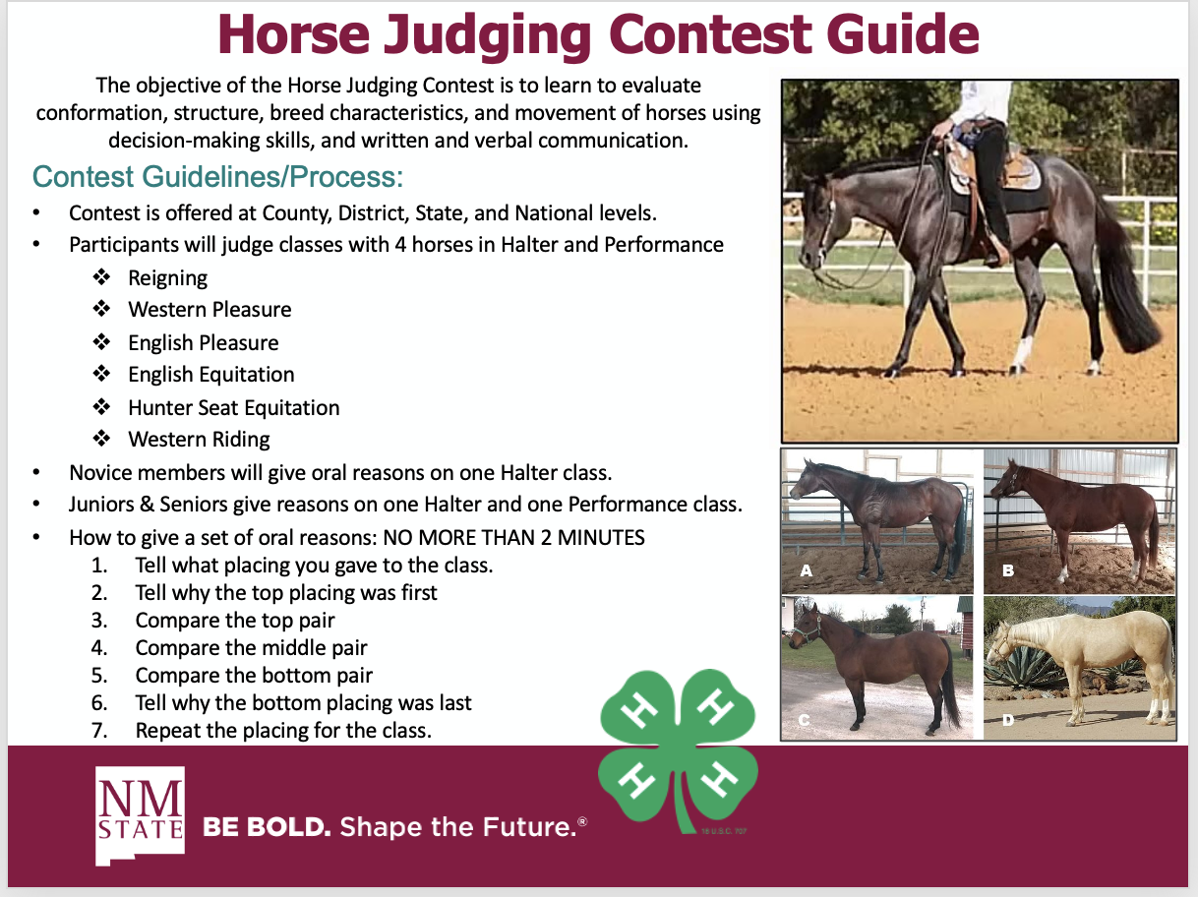
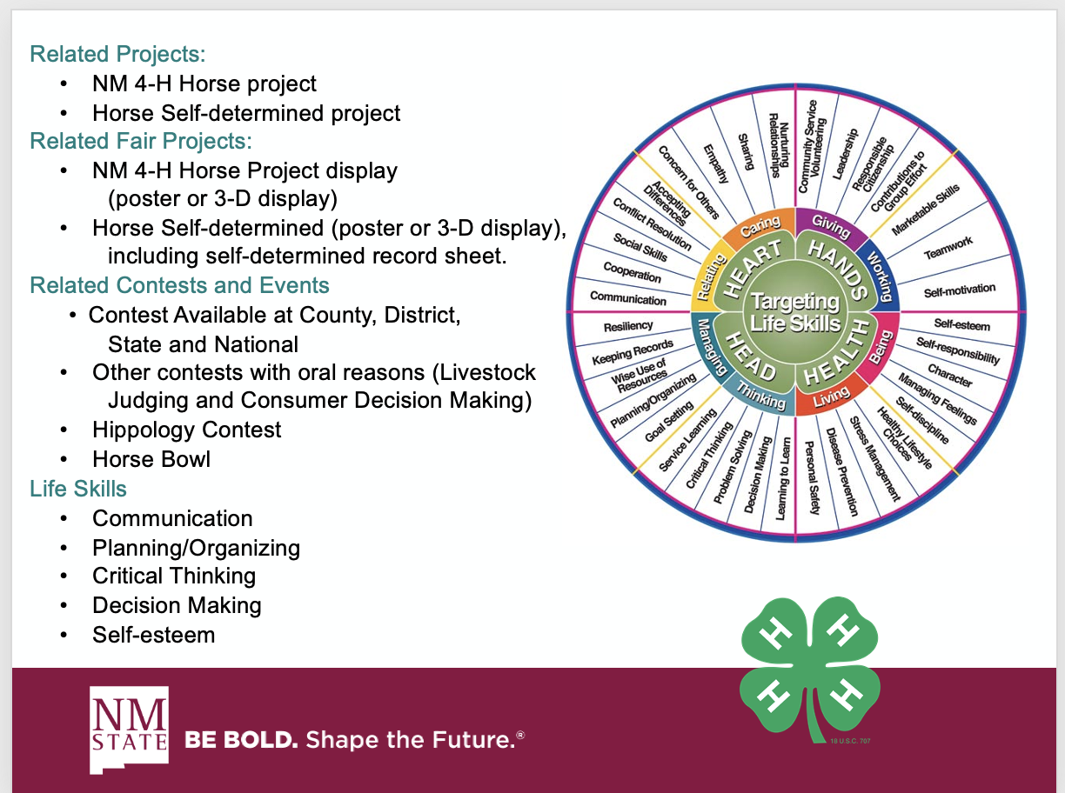
Contest Guides

Slide 5
Contest Carnival
Contests available in the contest carnival:
CDM
Entomology
Favorite Foods
FCS Skill-A-Thon
Horticulture
Livestock Skill-A-Thon
Presentations

Slide 6
Other Resources
Take 10 with 4-H
County Contest
District Contests
Judging Quick Facts

Slide 7
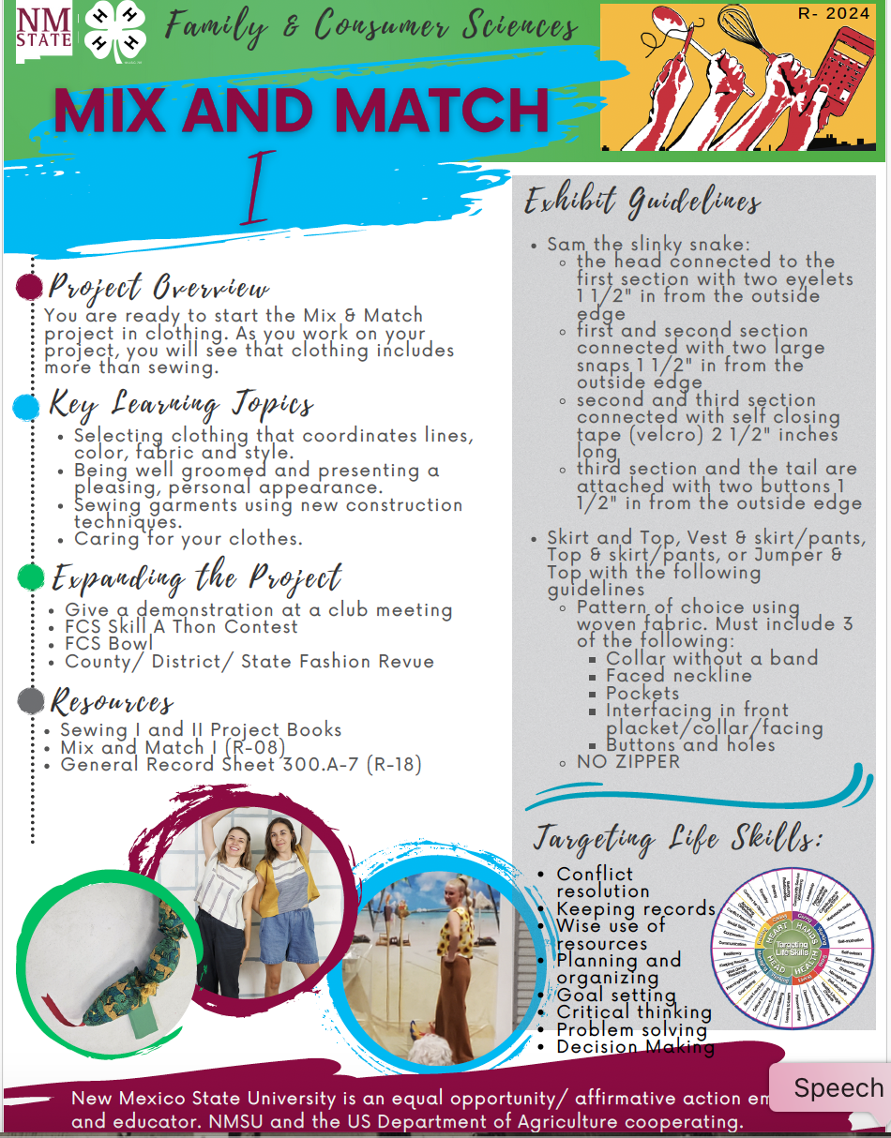
Project Green Tops and
Project Material

Slide 8
Thank you!!

